Slide 1
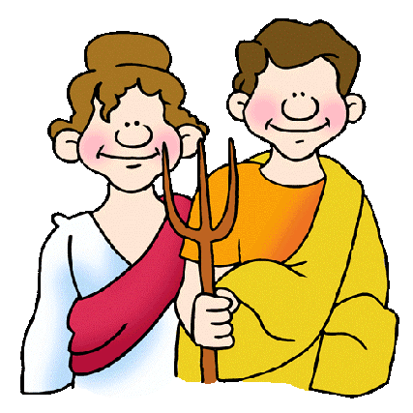
Daily Life in the Countryside

Slide 2
Although life was socially much slower paced than it was in the city, it was still Roman. The kids played the same games as kids did in the city. The atrium was the center of the home. The baths were an important part of daily life. There were many rural festivals to enjoy. They worshipped their gods each day.
Rich citizens escaped to their country estates to oversee their farms, but mostly to enjoy some rest from the social duties of the city. In the country, they enjoyed hunting, riding, fishing, and of course, the baths, dinner, and a busy social life between the villas.

Slide 3
The average farmer probably worked hard seven days a week, but enjoyed the local town on market day, selling his wares, meeting with friends, catching up with news. His wife looked after the house and family and supervised the slaves.
Dining was different than it was in the city. In the city, big meals were enjoyed in the late evening. On the farms, the day ended with an early meal, usually food left over from the large noon meal.

