Slide 1
Daily life in the Republic
By Aisling Cox

Slide 2
Rome grew from an important city into a huge, crowded, noisy, smoky, dusty city, with beautiful temples and public buildings. The rich had gracious homes, each with an entrance atrium, which was the centre of family life. For those who were not quite as rich, there were apartment buildings, some quite nice ones, and there were shabby tenements for the poor. Narrow streets wound between the seven hills.

Slide 3
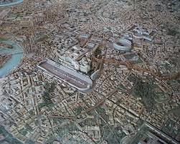
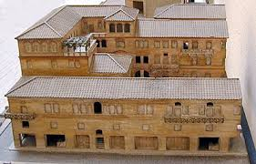

Slide 4
Some people walked around Rome. Some were carried in covered litters, with curtained couches carried on poles by slaves. Soldiers strode though town in chain mail or leather armor. Workmen hurried in belted tunics of dark wool. Before daylight, boys hurried to school. Later in the day, Roman citizens strolled around town in white wool tunics. Shops lined the streets.

Slide 5
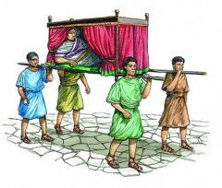
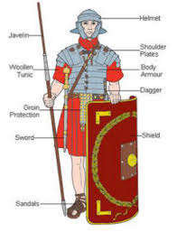
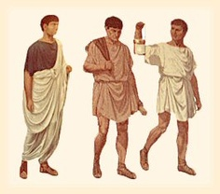

Slide 6
Down in the Forum, courts were in session, and the great Senate orators met and argued.

Slide 7
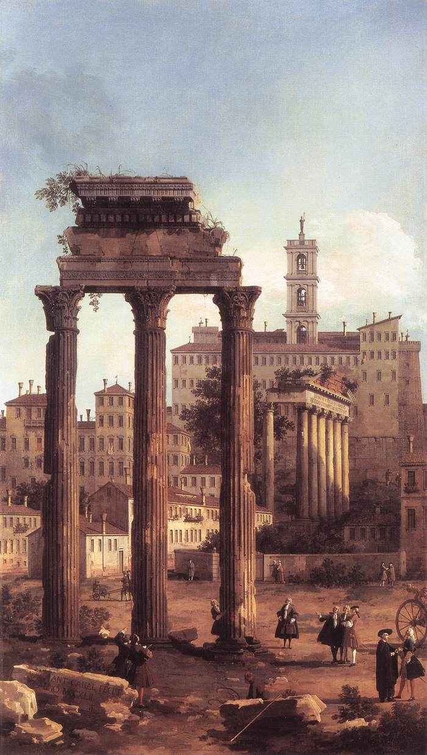
The Forum:

Slide 8
Even for the poor, life in the city was lively. There was always something going on, like the many religious festivals with entertainment paid for by the rich, and chariot racing with an open track that ran between the seven hills. These were free spectacles that all the people could enjoy.

Slide 9
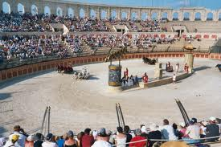
Chariot racing open track:

