Slide 1
Roman Gods and Goddesses
By Aisling Cox

Slide 2
Gods:
Honouring their gods was a big part of ancient Roman daily life.
There were many thousands of Roman gods. The ancient Romans believed that gods lived everywhere - in trees, under a bush, by the side of the road, in a burrow, in a flower, in a stream, under the bed, and perhaps even in the stove in your house.
Every day, the ancient Romans brought offerings of meat and other items to at least one nearby temple. Usually they visited more than one temple every day.
Each home had a personal household god that kept things running smoothly at home. Some ancient Romans kept a whole room of their house for a grand display to honour their personal household god. Others had a small display somewhere in the kitchen. Whenever the ancient Romans prepared a meal, they ate it in honour of the household god.

Slide 3
Gods:
Each time the Romans heard a myth about a god or goddess, if they liked it, they adopted it and made it their own. They adopted nearly all the Greek Gods!
There was a festival nearly every day for a God. Pax, for example, was the Roman goddess of peace. Her festival is January 3. Fornax is the Roman goddess of bread-making. Her festival is February 17.. Consus was the Roman god of good advice. He was so important that he had two festival days - August 21 and December 15, and a temple in the Circus Maximus.

Slide 4
12 major Gods:
These were called Olympians.
They lived on Mount Olympus.
In ancient Rome, the 12 major gods were called the Dei Consentes - the Roman Council.
The Dei Consentes was created after Hannibal had beaten the Romans badly in the north. Hannibal had not yet made it to Rome, but he was targeting Rome, and the Romans knew it.
The Roman Senate were advised to present a special public display honouring the top twelve gods, along with a special feast.

Slide 5
12 Major Gods
The Senate ordered six couches to be set up in public, and ordered their top artists to create sculptures of 12 god heads - no bodies, just heads.
Hannibal never made it to Rome, so the people believed that the display saved Rome!

Slide 6
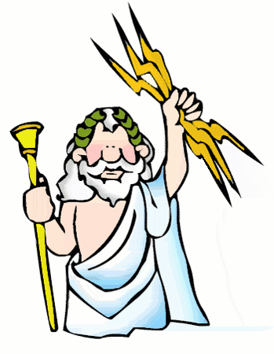
1. Zeus
Roman name: Jupiter
King of the Gods

Slide 7
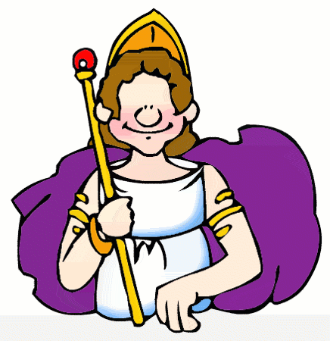
2. Hera
Roman name: Juno
Married to Zeus,
Queen of all Gods
Goddess of marriage

Slide 8
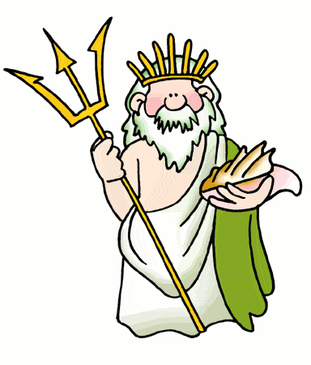
3. Poseidon
Roman name: Neptune
Lord of the sea
Brother of Zeus and Hades(God of the underworld)

Slide 9
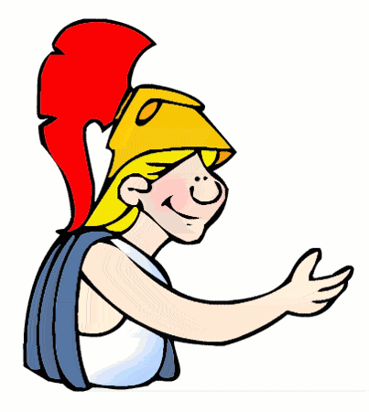
4. Athena
Roman name: Minerva
Goddess of wisdom
Daughter of Zeus

Slide 10
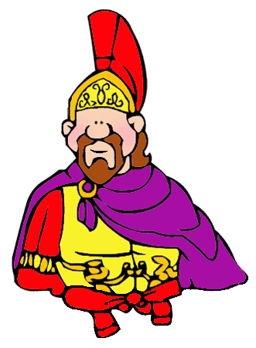
5. Ares
Roman name: Mars
A son of Zeus and Hera
God of war

Slide 11
6. Aphrodite
Roman name: Venus
Some say she was the daughter of Zues, others say she was born of sea foam.
Goddess of love and beauty

Slide 12
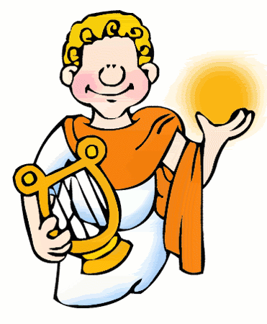
7. Apollo
Roman name: Apollo
Son of Zues & twin of artemis
God of music

Slide 13
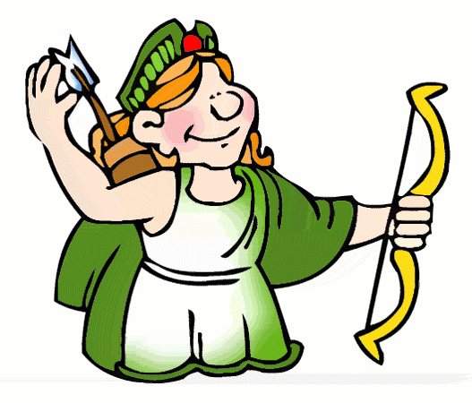
8. Artemis
Roman name: Diana
Daughter of Zues & Twin of Apollo
Goddess of the hunt and the moon

Slide 14
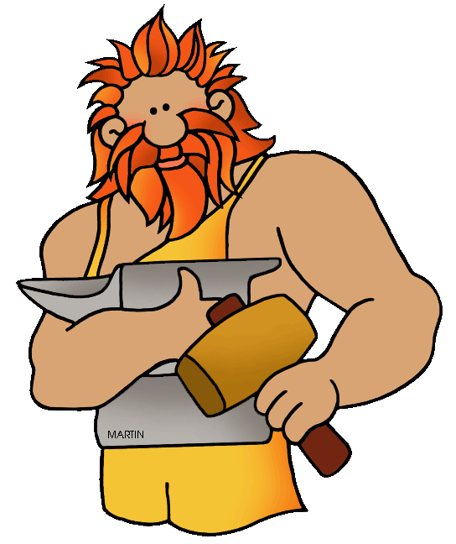
9. Hephaestus
Roman name: Vulcan
Son of Zeus and Hera
God of fire and forge

Slide 15
10. Hermes
Roman name: Mercury
Zues’s youngest son
Messenger of the Gods and God of commerce

Slide 16
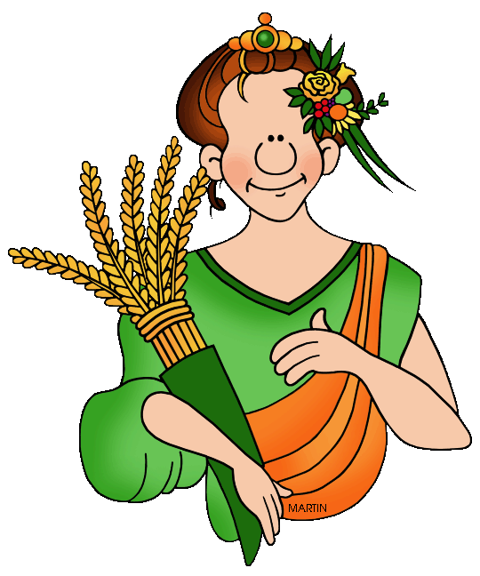
11. Demeter
Roman name: Ceres
Sister of Zues
Goddess of agriculture & harvest

Slide 17
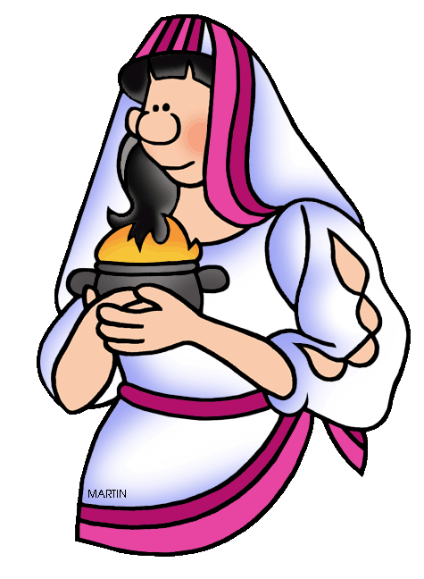
12. Hestia
Roman name: Vesta
Sister of Zeus
Goddess of home and Hearth

